Slide 1
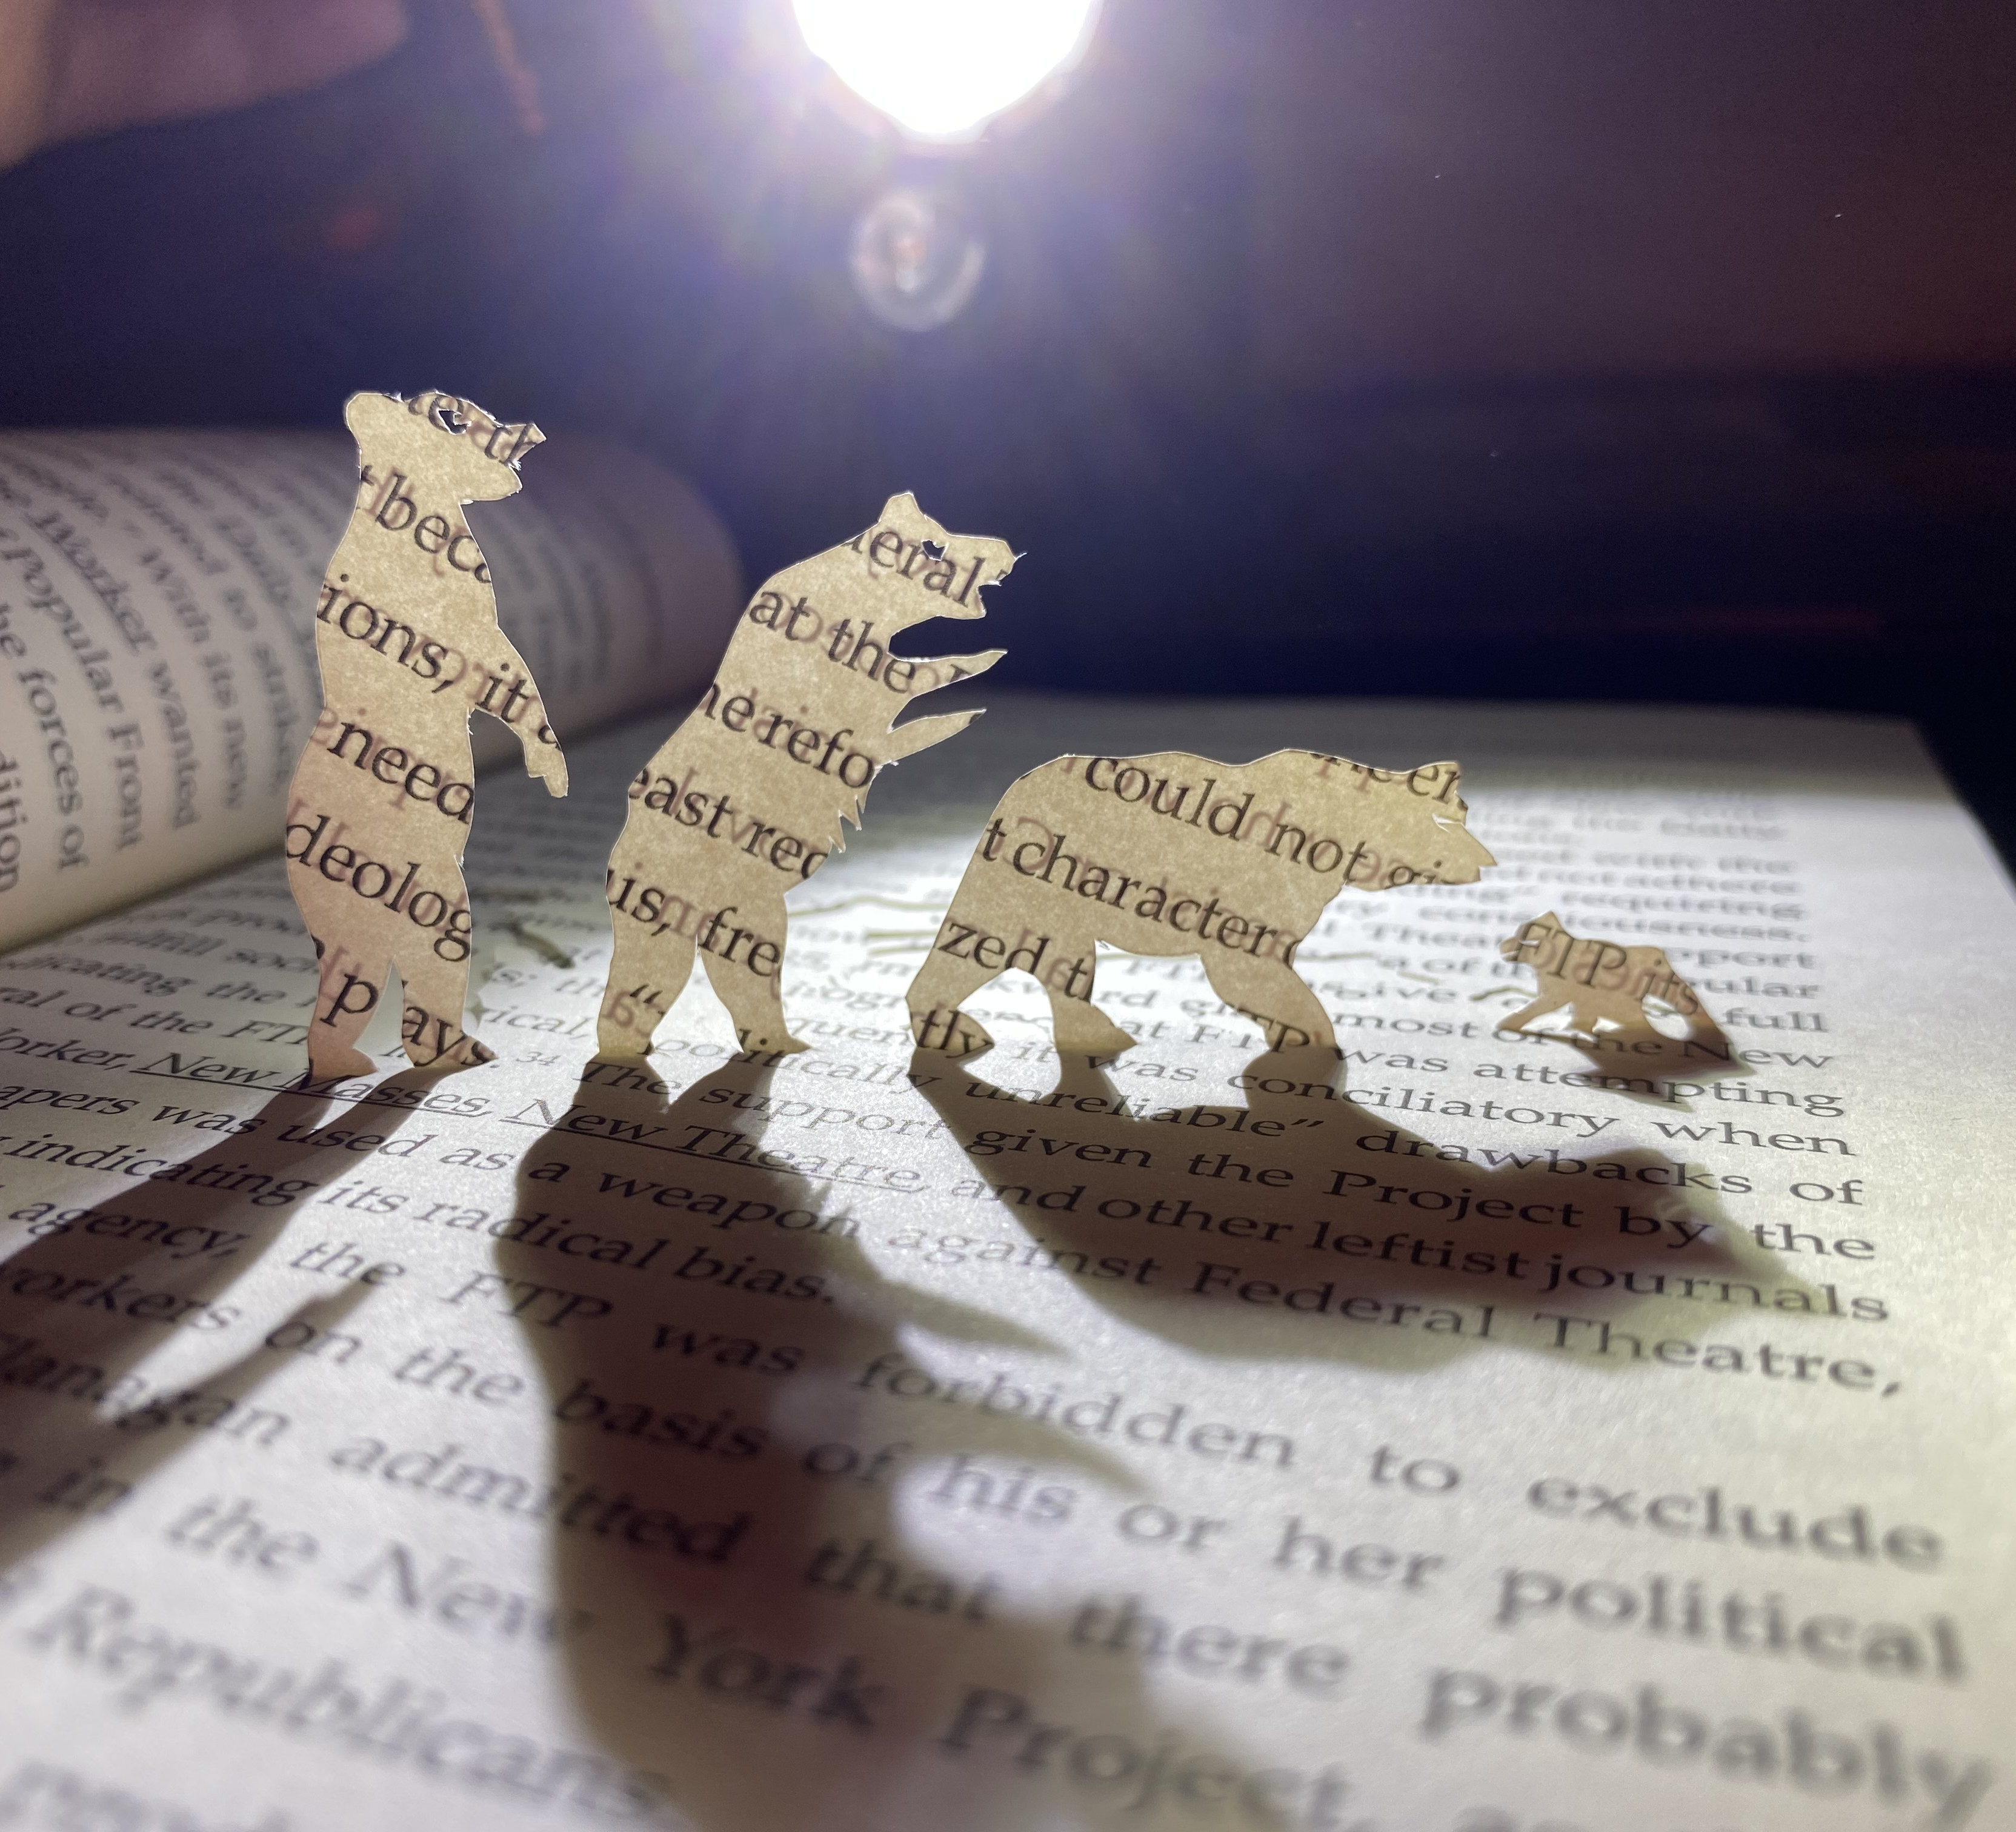
“Enter, pursued by a bear”, By Lady Kitt, Sarah lI and Edwin Li
A brief exercise (and musical accompaniment) for addressing / sharing/ thinking about Zoom Fear

Slide 2
What is “Zoom Fear” and how might this help?
"Zoom Fear" (“enter, pursued by a bear”*) describes negative feelings which can crop up before/ during video conferencing.
It’s feeling Kitt describes as being chased onto the screen followed by a cloud of doubt, confusion and anxiety, then having to do what is meant to come across as a carefully choreographed dance with the bear, but actually feels like barely disguised brawl.
This doc gives instructions / ideas for a short-5-10 mins, (mildly) interactive exercise, which aims to help groups collectively acknowledge and, (ideally) make a pal of, the bear.
* From the infamous Shakespeare stage direction, 'Exit, pursued by a bear’, Act III, The Winter's Tale

Slide 3
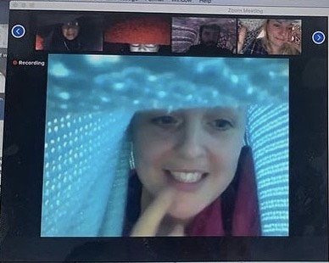
Resources- what you need for the exercise
a blanket or large piece of fabric
a scrap piece of paper (A4ish)
a pen / pencil
link to music by Sarah Li and Edwin Li
https://soundcloud.com/user-774962179/teddy-bears-picnic-silly-abstract-version
Image Credit: Rule of Threes, 2020
Image Description: A colour screenshot, interior. Computer screen with 5 people
(of various genders and ethnicities) appear in small oblong, video conferencing windows.
They have all put blankets over themselves and their computers, so they each appear to
be in a small colourful den. They are smiling.

Slide 4
Instructions- ideas for how to do the exercise
Invite participants to wrap themselves in their blankets then draw their blanket up over the back of their shoulders and heads moving closer to their webcams. They should then pull a portion of the blanket over the screen past the camera to create a blanket “den” in which both they and their camera/ screen are enclosed. Everyone then becomes inhabitants of the “Web of Dens” a caring, intimate and playful space created by Youngsook Choi (for more details see: https://www.lladykitt.com/together-ness-tools and https://youngsookchoi.com/ )
Introduce the idea of “Zoom Fear”: feeling of being chased onto the screen followed by a massive, scary bear of anxiety/ confusion/ terror
Talk about how generating a sense of intimacy and playfulness can help dispel this feeling
Introduce the idea of collectively making a pal of “the bear” / other representations of what a physical manifestation of that fear might be (this could be anything- dragons, clowns, a really big button with a menacing face)
Invite everyone to imagine that their “bear” is waiting outside the Web of Den- it cant get in- we’re completely safe here
Ask everyone to think of a kind, encouraging, friendly thing they could say to the other people on the zoom meeting / video conferencing event. I like to give an example of what I’m going to say, which is often something along the lines of “I feel so grateful to be here with you all and I’m dead excited to share the next couple of hours/ days together”
I like to give everyone a minute or so to think about what they might say and maybe play some calming music while they do this.

Slide 5
Explain the next 3 stages of the exercise before asking anyone to do any of them. It might also be useful to post the three stages in the chat box so people can remind themselves of what they are being invited to do
The next three stages are:
1. Invite everyone to draw a picture of their bear (or what ever else zoom fear / online facilitation anxiety) looks like to them. Explain that you will give them 2 minutes to do this, and whilst they do it you will play some appropriately themed music as accompaniment. (The specially composed work by Edwin Li and Sarah Li). Encourage people to draw quickly and not to be concerned about technical skill or beautiful draughtspersonship
2. Once the 2 minutes are up (and the music is finished) everyone is invited to put their drawings up in front of their faces, a bit like a makeshift mask, so the zoom/ video conferencing call becomes a gallery of Bears/ Zoom Fears
3. The facilitator will count to three. After the count of three everyone is invited to simultaneously say the kind, encouraging, friendly thing they thought up earlier. Hopefully this will fill the digital space with words of kindness, and encouragement spoken by our collective, assorted bears.
Everyone is then invited to remove their bear “masks” and come out of the Web of Dens, into their usual environment, where there won’t be any bears.

Slide 6
Notes
This exercise was devised by Kitt for "Taking Artist Development Online" at Chisenhale Studios, London (UK), Nov 2020
It is part of a loosely titled collection of resources called “Together-ness Tools”, which are a series of ideas for being close whilst socially distant​
“Together-ness Tools”, are created/ commissioned/ collected by artists Lady Kitt and Dan Russell (often in collaboration with others). There are also links to ideas and resources by other people, that we have found really useful in doing social art with social distance. It’s a work in progress and we are adding stuff and editing regularly. https://www.lladykitt.com/together-ness-tools
The musical work which accompanies this presentation is an original composition by artists Sarah Li and Edwin Li (https://www.starandshadow.org.uk/micro-projects/calves-hair-her/) , based on the song “Teddy Bear’s Picnic” which was written by American lyrist Jimmy Kennedy.

