Slide 1
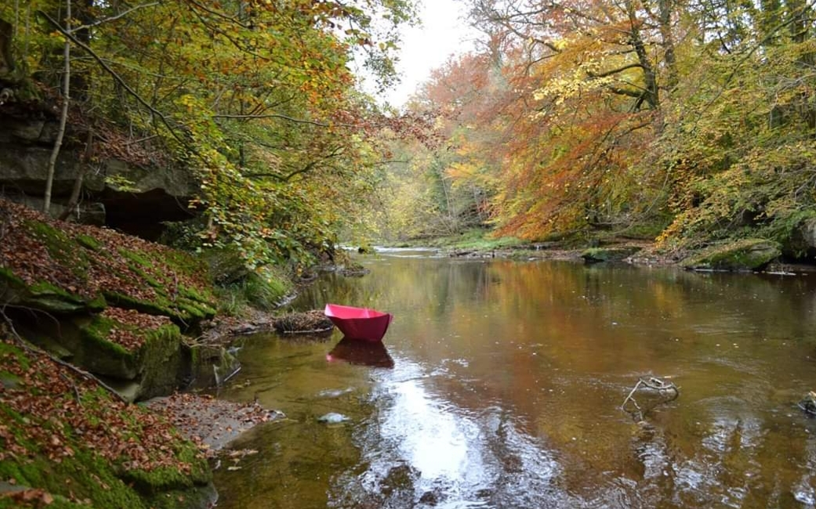
Walking, Talking and Listening
Ideas and methodologies for walking, talking and listening in general and “Sliding Scales of Silliness” events / workshops specifically, gathered and developed by Lady Kitt
Image description: photograph of a river with autumnal trees either side, in
the river floats a huge, pink, origami boat.
Image credit: Elaine Robertson, from “Conny Is Our Grand Tour” a socially engaged
project with Lady Kitt commissioned by “Conny Art Festival, 2019”, UK

Slide 2
Sliding Scales of Silliness- What’s the idea?
A structure for sharing challenges (whatever that might mean) within practice (whatever that might mean), whilst walking
Sliding Scales of Silliness- What’s the structure?
A short workshop (30 mins).
A group walk (1-4hrs).
Some reflective drawing (30mins).
(These timings are, as is most stuff in this resource, intended to be flexible)
Sliding Scales of Silliness- How did it start?
I was finding my own social art practice overwhelming- practically and emotionally. I wanted to be involved in creating situations for mutual support. It’s part of a larger collaborative, mutual support project with artist Dan Russel called “Social Practice Surgery”.

Slide 3
Walk.Talk.Listen.
Discussing challenges (whatever that might mean) within practice (whatever that might mean) whilst walking
Suggested structure for short, pre walk, workshop:
Opportunity for everyone to say who they are and why they are here (I recommend keeping this super concise and often give a time / word / sentence limit)
Intro to basic structure of “Sliding Scales of Silliness”: during the walk, the pace we each walk is dictated by how silly / serious we want the content of our discussions to be. If you feel you have something “serious” to talk about head to the front of the group, if something “silly” drift towards the back.
3. Give everyone an opportunity to think about what “challenges”, “practice”, “serious” and “silly” mean to them
4. Intro to the principles and benefits of Walk. Talk. Listen.
Walking offers physical and mental space
Talking offers opportunities to share difficulties and joys
Listening offers opportunities to learn and support
5. More detailed intro to exercises around walking talking listening
6. Health and Safety

Slide 4
Practical planning stuff I find useful
Asking myself why I want to do this activity? What do I want to achieve? Is this a suitable activity for the aims/ group/ setting?
Time of year- are there weather implications? It is a time when people are already dead busy?
Resources / materials: For this activity I recommend individuals bring suitable clothes, mobile phone, drink, backpack, any medication they may need. Organiser/ facilitator might want to provide: paper, pens, camera, media consent forms / emergency contact forms (and somewhere safe to keep them), risk assessment, map of route, 1st aid kit, evaluation forms, something to collect rubbish in
Route- is it safe, is it public land, is it suitable (somewhere with lots of background sounds isn’t great for the talking and listening!)? Do I know it well, so I can really focus on supporting the group and not thinking about the next bit of the route?
How will we/ do we need to evaluate, celebrate, share the event? I’m not big on documentation / evaluation unless there is a very clear purpose for it.

Slide 5
Emotional planning stuff I find useful
Tricks up my sleeve- I like to have a few ideas of how I will support people who might find the activity emotionally complex / difficult to engage with. During a walk I spend time with each walker and ask how they are feeling. Sometimes I sense that a particular person or smaller group / pair may be finding it difficult. Occasionally there will be situations where one person is monopolising another, maybe talking more and listening less. I will ask people directly if they feel they are talking or listening more. I also ask people if they feel they would like to move – are they feeling more serious / more silly now?! If things feel very static / lacking focus / not being that useful, I might get everyone to stop and then randomly assign group members numbers so they get mixed up for a while- there’s no pressure to stay in these groups for a certain amount of time.
It can be a very emotionally draining / enlightening experience for people involved, particularly facilitators / organisers. I like to make sure I’ve got time to decompress afterwards and like to plan a relaxing activity to do by myself. If you’re being funded to do this, please budget for facilitators / organisers to have paid time after the session to do any follow up (admin / emotional).

Slide 6
Accessibility, environmental impact and ethical issues- things I like to consider
Is the walk (and workshop venue) physically accessible/ safe for everyone involved? Access is not just about physical things - am I considering emotional, social and intellectual access too? Are the ways I’m communicating before, during and after the event accessible? There are some great resources and info relating to some of this here:
https://weareunlimited.org.uk/creating-an-accessible-event/
https://www.ramblers.org.uk/advice/walking-with-a-disability-or-health-issue.aspx
http://www.walkswithwheelchairs.com/
https://curiousarts.org.uk/training
If the walking element is problematic, are there other activities which could offer similar levels of structure, flexibility and gentle distraction in which to talk and listen? A Talk, Listen, Make “speed dating”- type situation can work well, as can a shared meal with people moving in between each of a series of mini courses
Are the materials used eco-friendly / ethically produced or managed (recycled paper, pens made from recycled plastics, are they sold by a company I feel works ethically?) If I’m booking venues (for example pub or café) do I feel the business has practices that reflect the ethical principles of the group? Including a stop at a venue which sells alcohol in the walk / at the end, can pose ethical issues.
Data protection in terms of contact details and images taken during the event. How will I communicate these, save any data (including images), credit images?

Slide 7
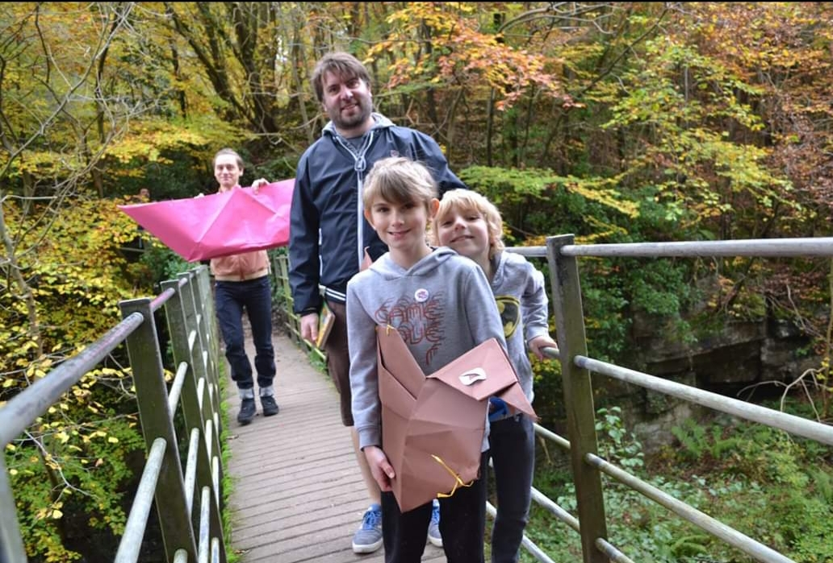
Intro to basic
principles of
“Sliding Scales
of Silliness”.
The pace we travel whilst doing this walk, is dictated by how silly / serious we want the content of our discussions to be.
Extremes of : serious to the front, silly to the back
Replacing the traditional group walking formation: naturally-fast/ secretively-comparative/ desperately-trying-to-walk-off-stress to the front > naturally-slow, struggling-to- keep-to-keep-up, people-gossiping, to the back.
Hopefully walkers will move in both directions. There is no method for who moves where when. Be honest. Be safe. Be thoughtful. Be kind.
It’s always gratifying if, by the end, everyone is ambling along at the "back-ish" in relative silliness having walked off / talked through some burning seriousness, but there should be no pressure for this to be the outcome!
Image description: a photograph of four smiling humans (two adults, two children) crossing a small foot bridge, one carries huge, pink, origami boat.
Image credit Elaine Robertson, from “Conny Is Our Grand Tour” at Conny Art Festiva,l 2019

Slide 8
Ideas for thinking about what “challenges”, “practice”, “serious” and “silly” mean to us
This can be done in a huge number of ways. For me it’s important to ensure that everyone involved has an opportunity to think about their own definition of each of these 4 words. You’ll know the kind of stuff which suits you/ the group best. Below are a few suggestions.
Ask the group to sit with their eyes closed and think about what each word means to them. Give a specific amount of time and then ask everyone to open their eyes together or ask people to open their eyes individually when they feel they have finished.
Split the group into smaller groups and ask them to discuss what each term means to them.
Give everyone drawing materials and ask them to draw a small images of / cartoon about/ response to each of the four words.
Divide the group into pairs and ask them to tell one another a story or anecdote which reflects their understanding of one or several of the words (with this it would also be important to offer a short time to think about individual definitions of any words not featured in the story!).

Slide 9
Definitions
“challenges”, “practice”, “serious” , “silly”
Below is stuff people have said in previous workshops. These are intended purely as examples/ prompts. I don’t feel there are any right / wrong answers / suggestions
Challenges: “Issues, problems”, “Barriers I face, situations stopping me from doing the work I need to do”, “Complications, I suppose, these can be financial, structural, to do with wellbeing, the support I can access and people. People find people challenging!”
Practice: “The way I make work”, “Processes”, “Communication, collaboration, solitarily and hope”, “Objects and the way they are made. The thinking that goes into them and the technical skill”, “doing art”
Serious: “weighty”, “Consequences that effect the substance of people's lives: health, ability to work, relationships, having a roof over ones head and food to eat”, “Things which could stop a project from working. A complete breakdown of communications, ill health (physical or mental) could stop someone from working” “artist loosing something which allows them to carry out their practice, for example a vehicle, a house , a studio” “Life changing”
Silly: “My dog comes to the studio with me and keeps sitting on my laptop”, “a problem that is kinda anecdotal- someone else might find it funny!”, “Irritating rather than devastating”, “weird stuff”, “something it would be good to sort out, but in no way vital”

Slide 10
Intro to principles and benefits of
Walk. Talk. Listen.
Walking can offer physical and mental space. Group walking often has a culture all of its own, it is a place where we can be allowed to talk, think and listen more slowly and with more focus than in other contexts. Walking is demonstrably multi-sensory. This can encourage us to consider more embodied approaches to complex situations.
Talking is something most of us do a lot of the time, it can offer opportunities to share complex thoughts and situations, to be vulnerable, to connect. Often we don’t give ourselves much chance to think deeply about the positive things talking offers us, or about how to talk in different, maybe, more useful ways.
Listening can offer opportunities to learn, empathise and support. Often the feedback from these walks is that people feel they gained more from the listening than they did than from the talking.

Slide 11
Tips
The following tips on Walking, Talking and Listening are only vague guides, things I've discovered and found useful for these events and in many other settings and situations
Feel free to use the ones that work for you/ ignore the ones that don’t / add new ones
There are a huge variety of ways you could communicate these tips to a group- games, exercises, drawings, flash cards, and just chatting about them. It can often benefit everyone to have them in advance via post / email etc. People frequently ask for a copy to take away with them, so it can be useful to provide this.
I've learned, discovered and develop these in lots of different place and from / alongside many people and organisations. It’s impossible to mention them all, but the following have been particularly important:
Headway Arts Northumberland, Disability Arts http://headwayarts.co.uk/headway-arts-online/
Dr, Sheila Preston, Thriving facilitators https://thriving-facilitators.mn.co/
Bigfoot Arts Education http://bigfootartseducation.co.uk/training/
Bridie Jackson, Socially engaged composer http://www.bridiejackson.com/education/4590817444

Slide 12
Walking tips
Be safe: think about your own and others safety
Be considerate: think about how close you are walking to someone, your pace- are people struggling to keep up with you? As a group try not to dominate the space.
Talking tips
Give yourselves an opportunity to consider what you want to talk about before the walk starts.
Give yourselves an opportunity to consider how you are going to say what you want to say, what is the essence of the challenge / problem you want to discuss?
Think about how you are talking? Loud, soft, fast, slow? The words you are using.
Focus on being understood, not in being impressive/ wordy/ knowledgeable.
Take time to notice and process the physical and spoken reactions of the person you are taking to.
If you are comfortable to, make eye contact from time to time (without losing sight of where you're walking!)
Aim to listen more than you talk

Slide 13
Leave time (for people to speak, for people to finish speaking, for people to think before they speak).
Listen to understand, not just to formulate your own response.
Ask open questions. Open to more than “yes”/”no” answers.
Paraphrase to make sure you’ve understood.
Make eye contact (see Talking Tips).
Be prepared to be vulnerable, be aware that people may have strong reactions.
Aim to listen more than you talk. Be kind. Say thank you.
Listening Tips
(I like to ask a group to close their eyes and listen to me read out these tips)
(Once people have opened their eyes, I like to ask for a few examples of open questions)

Slide 14
Before you set off
Ask if anyone has any questions / suggestion before you set off
Mention any health and safety things you feel are important (maybe check all the forms you need filling in are filled in, check everyone has water, suitable clothes etc)
I always like to suggest everyone goes to the loo before setting off, mostly because I've forgotten to do this myself a few times before a walk and then spent the whole time thinking about peeing instead of enjoying the walk
During the walk
Plan a short break mid way through to gather everyone and make sure people are ok, also another opportunity to go to the loo
Keep checking in on people (See Emotional Planning Slide 4)

Slide 15
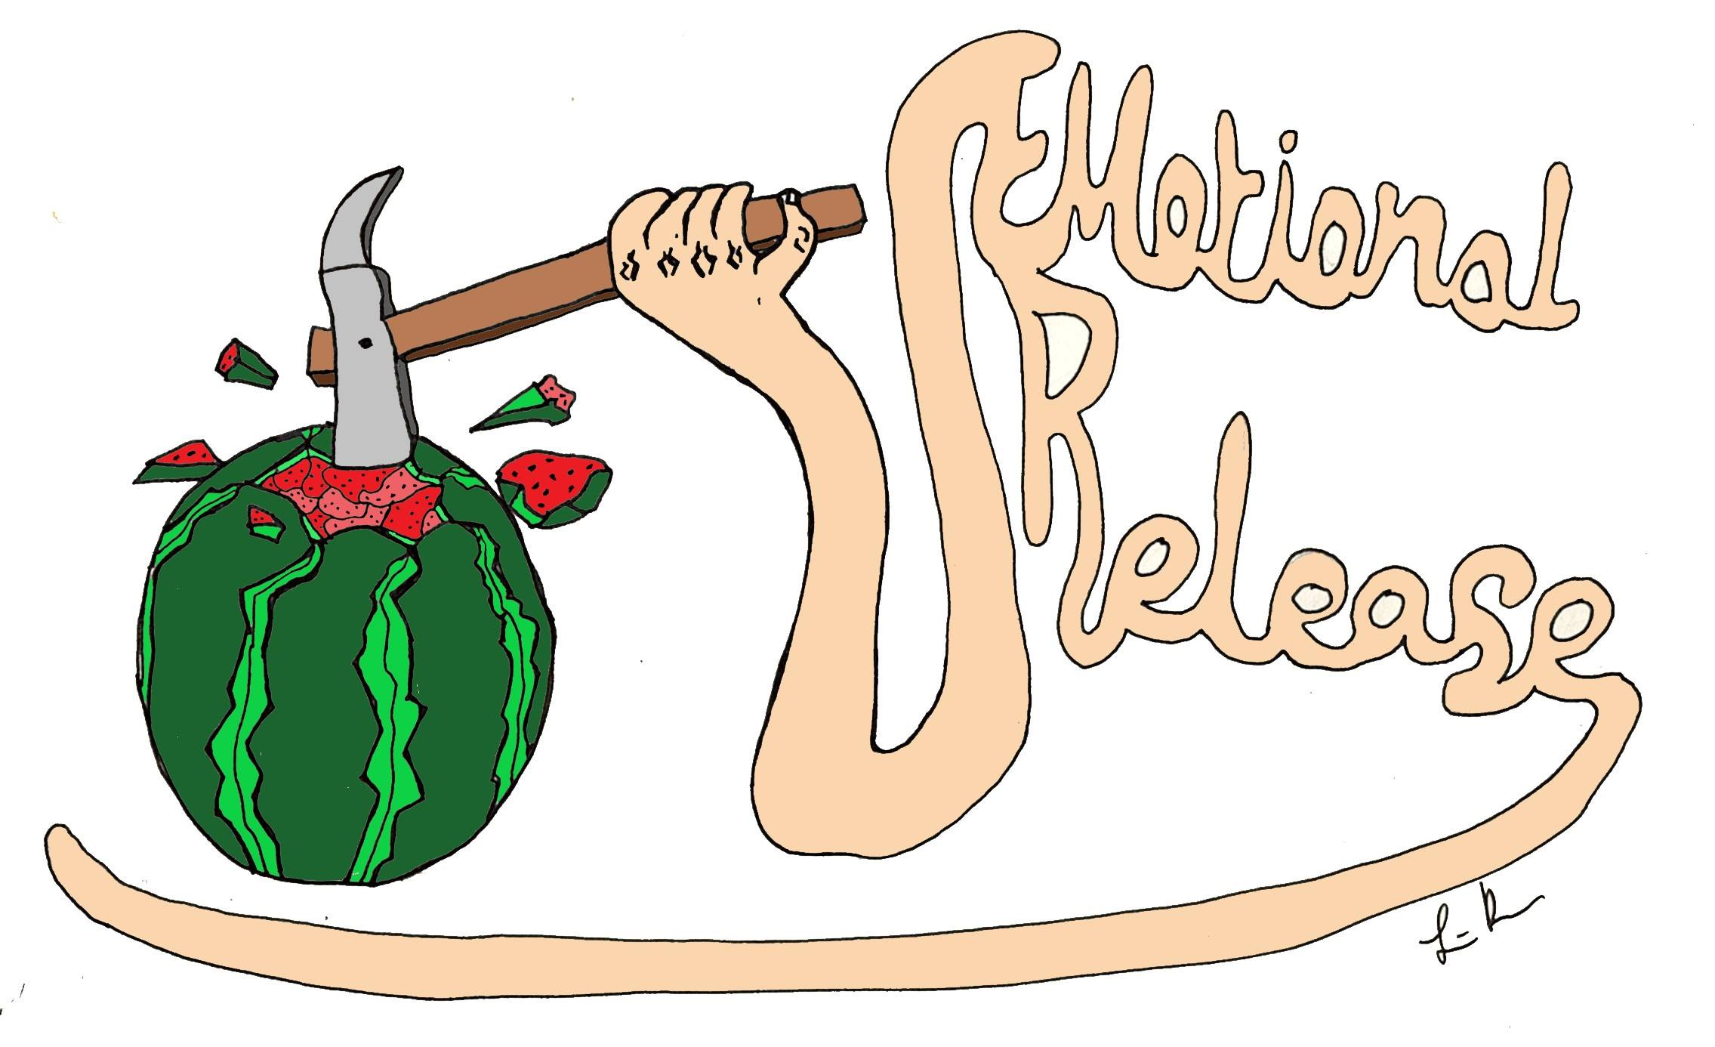
This can be individual or collective
I like to think of it as mapping the process and recording:
Useful advice offered/ resource(s) suggested
A memorable /breakthrough moment
I like to remind a group that the purpose of the reflective drawing is to record information and feelings that were important to you, in a way which will help you to remember them. It’s not about making something that looks “good” or “impressive”.
Reflective Drawing ideas
Image description: Colour illustration showing a pink arm, at one end it has a hand holding a hammer. The hammer is smashing off the top of a water melon. The other end of the arm is bent and folded into shapes which spell out the words “Emotional Release”
Image credit: Louise Brown / GoodStrangeVibes, Commissioned by Axisweb as part of Social Practice Surgery at “Social Works? Live” based on a suggestion by artist gobscure

Slide 16
After the session
Check in with people to find out how they’re feeling.
Make sure wherever you’ve been wandering / drawing is left rubbish free
Forms- store / dispose of safely
Remember to credit photographers if you use pics after the event. I also think it’s important to credit co authors (walkers) on images of any drawings / writing/ objects produced during the event- if they have agreed to this!

Slide 17
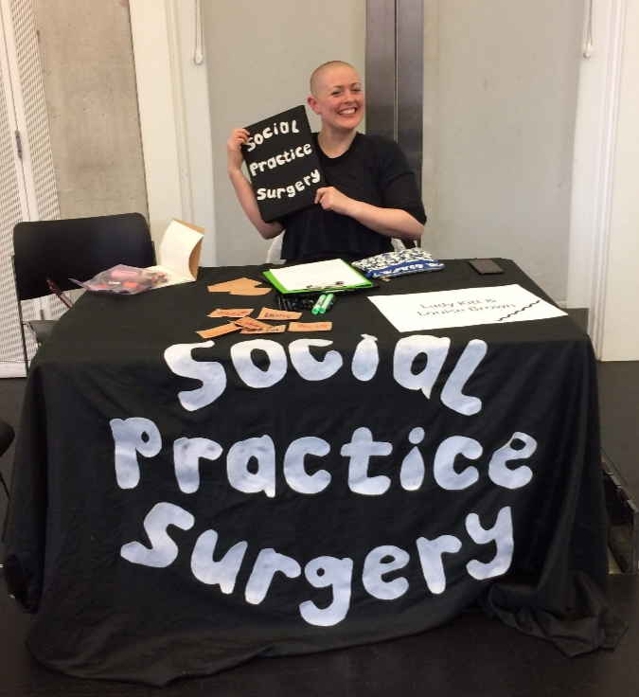
Links that might be useful:
Social Practice Surgery
https://www.lladykitt.com/blank
Social Art Network resources https://www.socialartnetwork.org/resources
Other walkers:
https://ravenellison.com/
https://www.walkingartistsnetwork.org/about/
https://www.inspirallondon.com/projects/walking-otherwise-2020-visions/
Image description: Photography of Lady Kitt, a shaven headed human, sitting behind a table with a black table cloth. The words “Social Practice Surgery” are cut from white felt and sewn to the portion of the cloth hanging from the front of the table
Image credit: Louise Brown, taken at Axisweb “Social Works? Live”, Manchester School of Art, UK 2019

